Slide 1


Manual Briefing: Theories of Change for Early Actions
Presented by:
Arielle Tozier de la Poterie
Global Early Action & Research Advisor

Slide 2
When in the process of selecting early actions should I develop theories of change (ToCs)?
Prioritizing impacts
Identifying potential early actions
Developing & Testing Theories of Change
Identifying impacts
Prioritizing early actions
Once you have narrowed your actions
Develop a ToC for each action under serious consideration
You may still discard an action after this step

Slide 3

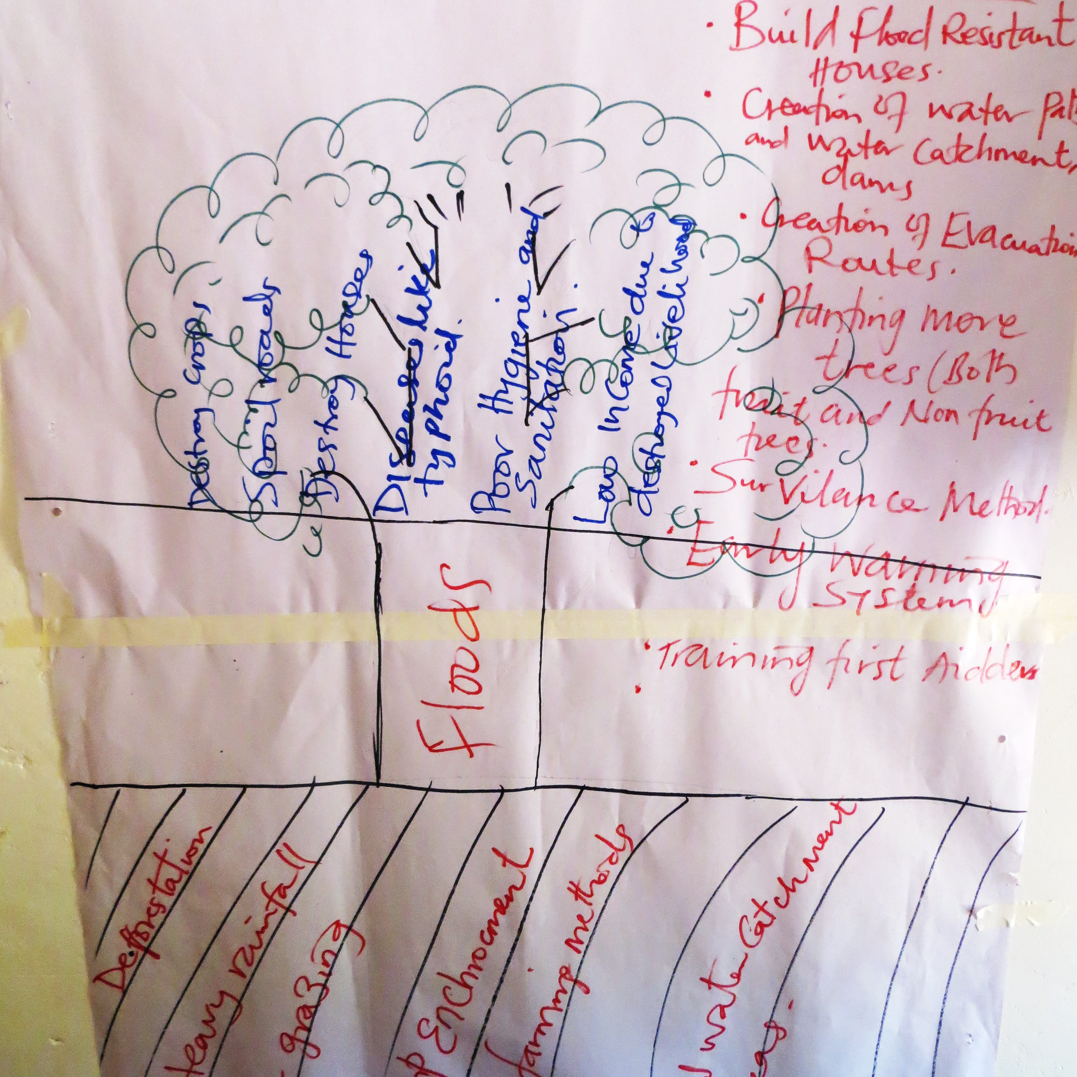
Presentation Overview
What is a ToC and what is it useful for?
1
What are the components of a ToC
2
How can you develop a ToC
3
Fatal assumptions
4
Activity / walk through (?)
5
Notes:
Caveat – I do not think the the ToC table in the EAP template is an actual ToC.

Slide 4
Why a theory of change?
Desired future situation
We make (intuitive) assumptions ALL THE TIME!
Initial situation
What should change, for whom, and why?

Slide 5
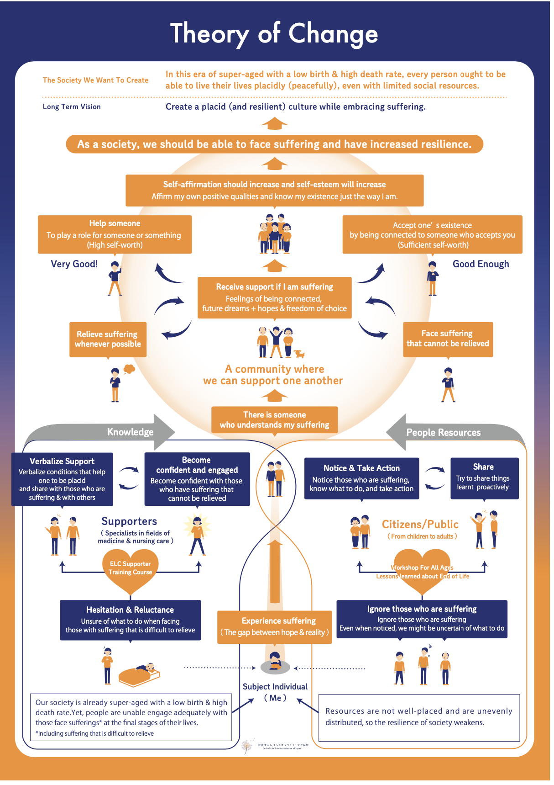
Why a theory of change?
Transparency & Clarity
Be clear about where you want to go & how you will get there
Monitoring & Learning
Identify which elements to monitor
Which elements to change
Image credit: theoryofchange.org

Slide 6
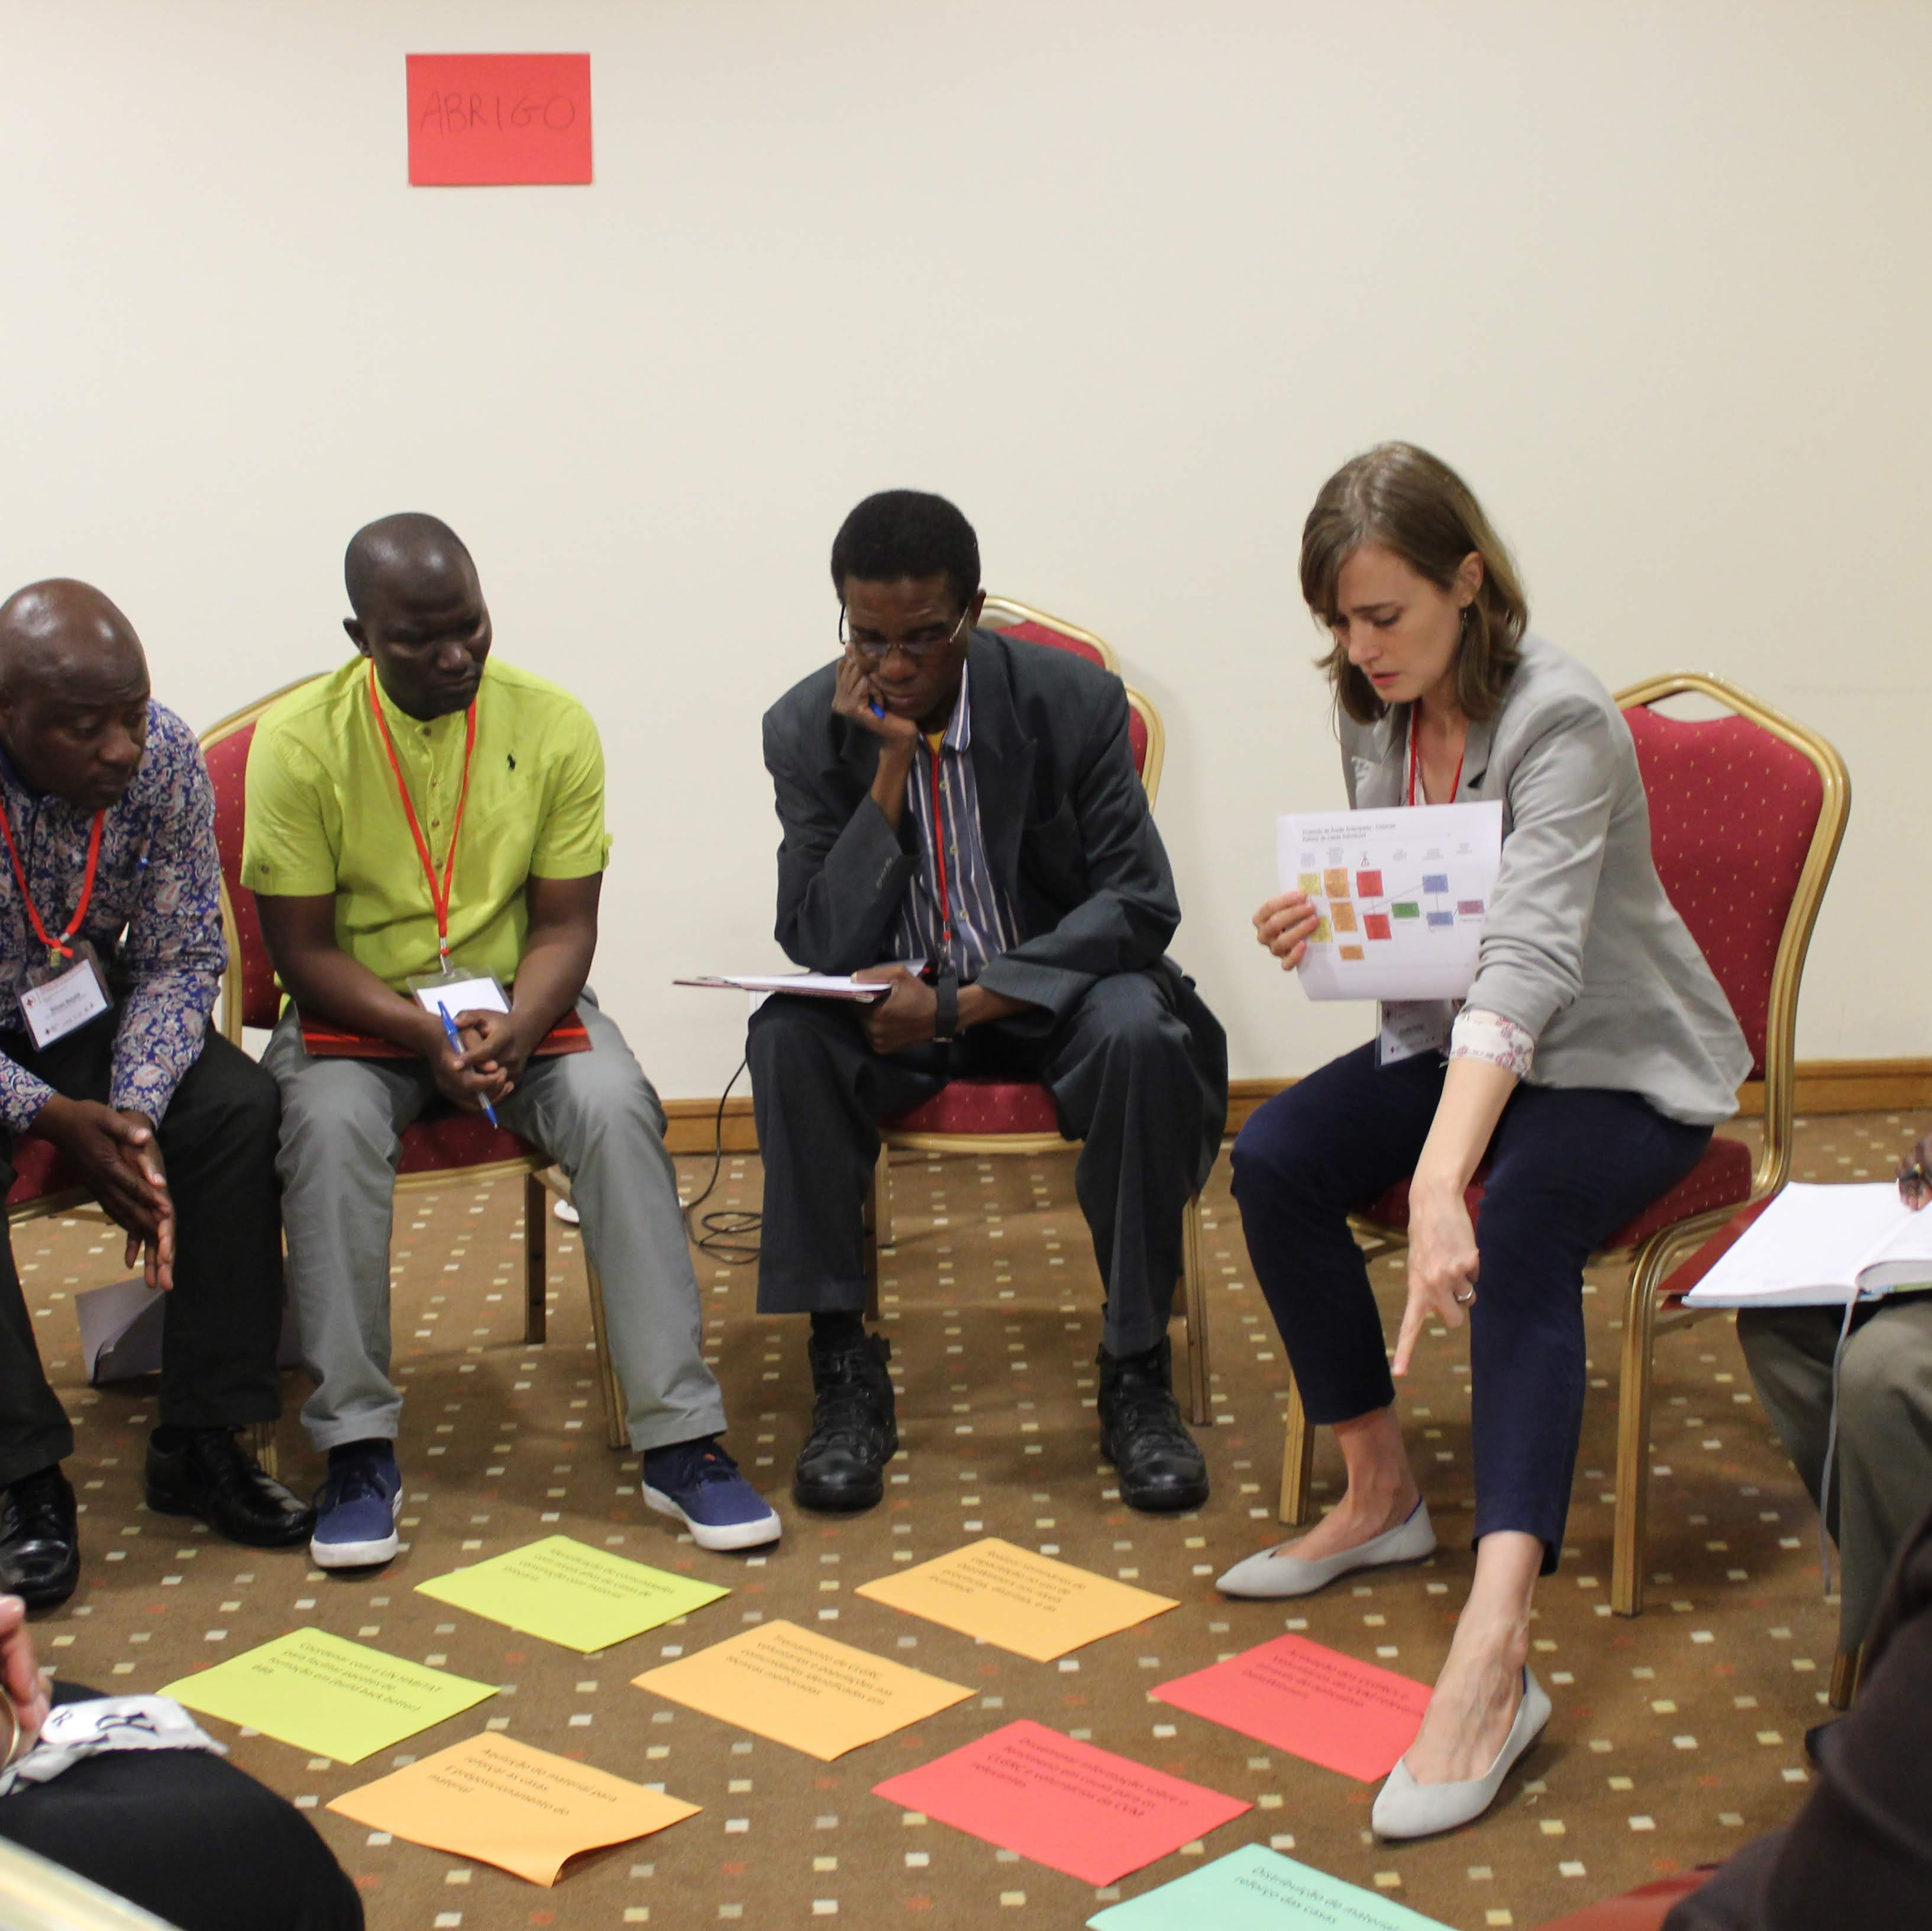
Insert a grayscale map of the pilot country and pinpoint the exact location as seen here.
How to develop a ToC

Slide 7
Step 1: define the problem and the goal
Define the objective in relation to a specific problem
The end goal/objective is often the opposite of the problem you are trying to solve; the desired impact (of your program)
Key questions
What is the problem?
What is the impact we want to reduce with early action?
How can we reduce this impact?
Problem | Goal/Objective
Cyclones destroy houses | Reduce the number of houses destroyed/damaged
Ashfalls destroy crops | Reduce damage to crops
Floods contaminate water; without clean water people and animals get sick | Reduce the incidence of waterborne diseases
People die trying to cross flooded rivers and streams | Reduce the number of fatalities from dangerous river crossings

Slide 8
Step 2: map the process of change
Helpful tips:
Work backward from desired outcome
Test your logic using ”if…then” statements
Final Objective
Early Action
Early Action
What must be done to prepare for the activity?
What must be done to prepare for the activity?
What must be done to prepare for the activity?
What must be done to prepare for the activity?
Etc.
Etc.
Etc.
Etc.
Etc.
Etc.
Etc.
First step to achieving your goal

Slide 9
Step 2: map the process of change
Elements of the process to map
Define your goal & work backward
Example: reduce damage to crops from ashfall
Preparedness Activities
Early Actions
Pre-activation Activities
Trigger/
Activation
Outcomes
Goal/Final Objective

Slide 10
Step 2: map the process of change
Preparedness Activities
Early Actions
Pre-activation Activities
Trigger/
Activation
Outcomes
Goal/Final Objective

Slide 11
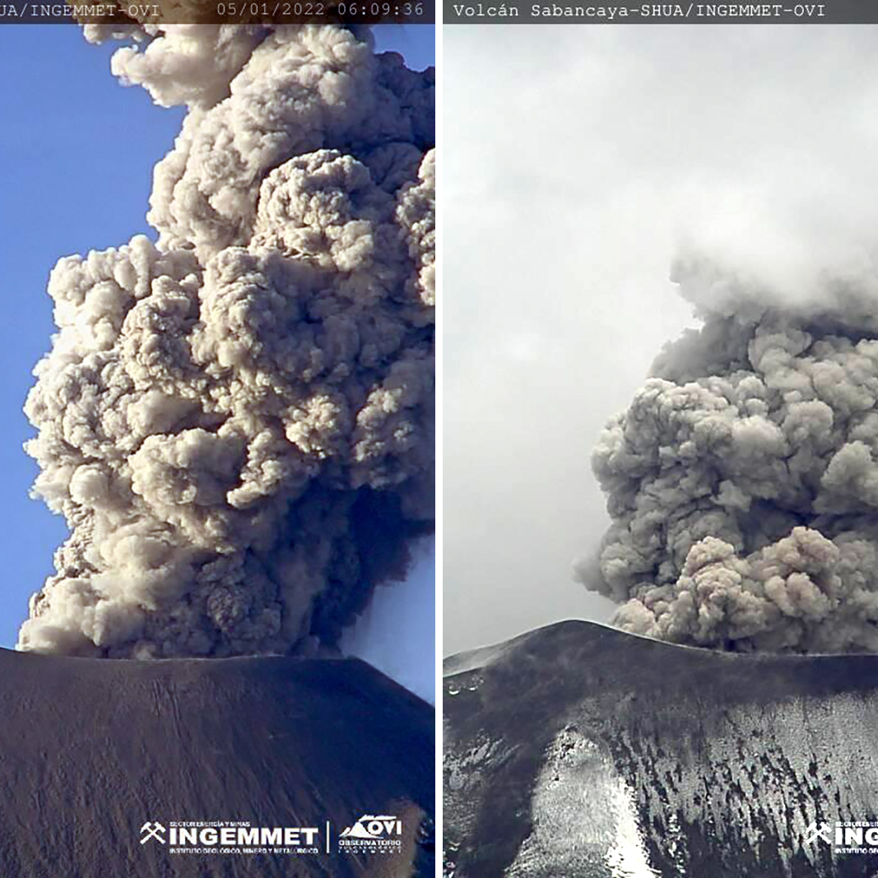
Step 2: map the process of change
Define the outcome: the change in behavior that will lead to your anticipated results
Outcomes ≠ final objective or desired impact
Example:
Action = distribution of tarps to protect crops
The outcomes is that people use tarps to protect their crops (the behavioral change)
If access to tarps is sufficient to reduce damage to crops, this behavior change will result in the final objective (impact): fewer crops lost

Slide 12
Step 2: map the process of change
Define early actions
Who will do what, when, where, how?
What kind of guidance will accompany the early actions? (e.g how to use the kits etc).
Preparedness Activities
Early Actions
Pre-activation Activities
Trigger/
Activation
Outcomes
Goal/Final Objective

Slide 13
Step 2: map the process of change
Preparedness Activities
Early Actions
Pre-activation Activities
Activation/
Trigger
Outcomes
Goal/Final Objective
Notes:
Tiene que definir e mapear cada elemento (no necesariamente en orden)
Actividades preparativos
Preparación, pre-posicionamiento, y desarrollo de capacidades
Administrativos
Acciones previas al desencadenamiento/ preactivación (si es aplicable) (pre-trigger, early trigger)
Desencadenar
Acciones tempranas
Los resultados
Meta/objetivo final

Slide 14
Step 2: map the process of change
Map the trigger/communication process
Hydro-met services alert the National Society HQ
Volunteers alert communities
National Society alerts branches
Branches alert volunteers

Slide 15
Step 2: map the process of change
Preparedness Activities
Early Actions
Pre-activation Activities
Trigger/
Activation
Outcomes
Goal/Final Objective

Slide 16
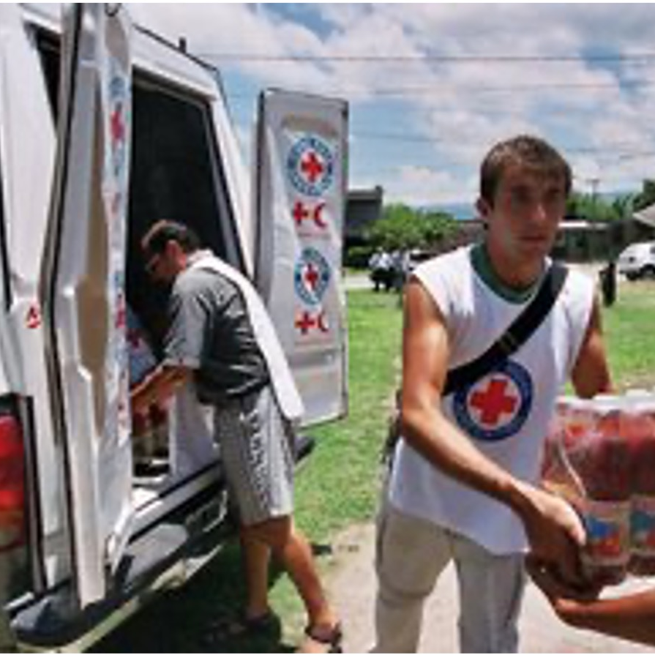
Step 2: map the process of change
Define pre-trigger activities (if applicable)
Examples:
Identifying beneficiaries (verifying lists)
Verifying pre-positioned stocks
Loading trucks
Informing personnel

Slide 17
Step 2: map the process of change
Preparedness Activities
Early Actions
Pre-activation Activities
Trigger/
Activation
Outcomes
Goal/Final Objective

Slide 18
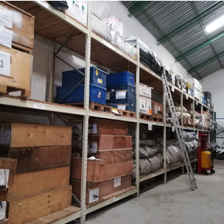
Step 2: map the process of change
Define preparatory actions
Administrative examples:
Identify partners
Identify potential beneficiaries/mapping
Preparatory examples:
Workshops
Training
Produce educational materials
Acquire supplies
Pre-position supplies

Slide 19
Preparedness Activities
Early Actions
Pre-activation Activities
Trigger/
Activation
Outcomes
Goal/Final Objective
Fewer crops lost
Use the tarps
Use the tarps
Early Action: demonstrate using the tarps
Early Action: Distribution of tarps
Pre-position supplies
Initial volunteer training
Purchase supplies
Volunteer refresher training
Register potential beneficiaries
Plan volunteer training
Notes:
definition of pre-trigger activities (if applicable)

Slide 20
Step 3: make assumptions explicit
Definition of Assumption:
An external factor (beyond the control of the project) that is critical for project success.
It must hold true for the intervention to succeed
Notes:
Pre-positioned items may also be used for response. Once procured, it’s hard to keep it there if people know it’s there and there is a need.
ONce stufff is there, hard to keep it in response scenarios.

Slide 21
Step 3: make assumptions explicit
Preparedness Activities
Early Actions
Pre-activation Activities
Trigger/
Activation
Outcomes
Goal/Final Objective
Fewer crops lost
Use the tarps
Use the tarps
Early Action: demonstrate using the tarps
Early Action: Distribution of tarps
Pre-position supplies
Initial volunteer training
Purchase supplies
Volunteer refresher training
Register potential beneficiaries
Plan volunteer training
Assumption!
Assumption!
Assumption!
Assumption!
Notes:
definition of pre-trigger activities (if applicable)

Slide 22
Step 3: make assumptions explicit
Example: Assumptions behind distribution of veterinary kits and tarps to protect animals from the cold
Name an assumption
Reduce the number of alpacas who die or fall ill in the cold
Use the tarps
Early Action: Distribution of tarps & vet kits
Pre-position animal kits
Purchase tarps and vet supplies
Register potential beneficiaries
Notes:
Tiene que definir e mapear cada elemento (no necesariamente en orden)
Actividades preparativos
Preparación, pre-posicionamiento, y desarrollo de capacidades
Administrativos
Acciones previas al desencadenamiento/ preactivación (si es aplicable) (pre-trigger, early trigger)
Desencadenar
Acciones tempranas
Los resultados
Meta/objetivo final

Slide 23
Step 3: make assumptions explicit
Trucks will be available; roads will be passable (not too icy)
People will use the tarps for the animals rather than their homes
People will be willing to vaccinate their animals
People will know how to use the kits
Reduce the number of alpacas who die or fall ill in the cold
Use the tarps
Early Action: Distribution of tarps & vet kits
Pre-position animal kits
Purchase tarps and vet supplies
Register potential beneficiaries
Notes:
Tiene que definir e mapear cada elemento (no necesariamente en orden)
Actividades preparativos
Preparación, pre-posicionamiento, y desarrollo de capacidades
Administrativos
Acciones previas al desencadenamiento/ preactivación (si es aplicable) (pre-trigger, early trigger)
Desencadenar
Acciones tempranas
Los resultados
Meta/objetivo final

Slide 24
Step 3: make assumptions explicit
If you can control/influence the assumption, add it to your ToC
Reduce the number of alpacas who die or fall ill in the cold
Use the tarps
Early Action: Distribution of tarps & vet kits
Pre-position animal kits
Purchase tarps and vet supplies
Register potential beneficiaries
Notes:
Tiene que definir e mapear cada elemento (no necesariamente en orden)
Actividades preparativos
Preparación, pre-posicionamiento, y desarrollo de capacidades
Administrativos
Acciones previas al desencadenamiento/ preactivación (si es aplicable) (pre-trigger, early trigger)
Desencadenar
Acciones tempranas
Los resultados
Meta/objetivo final

Slide 25
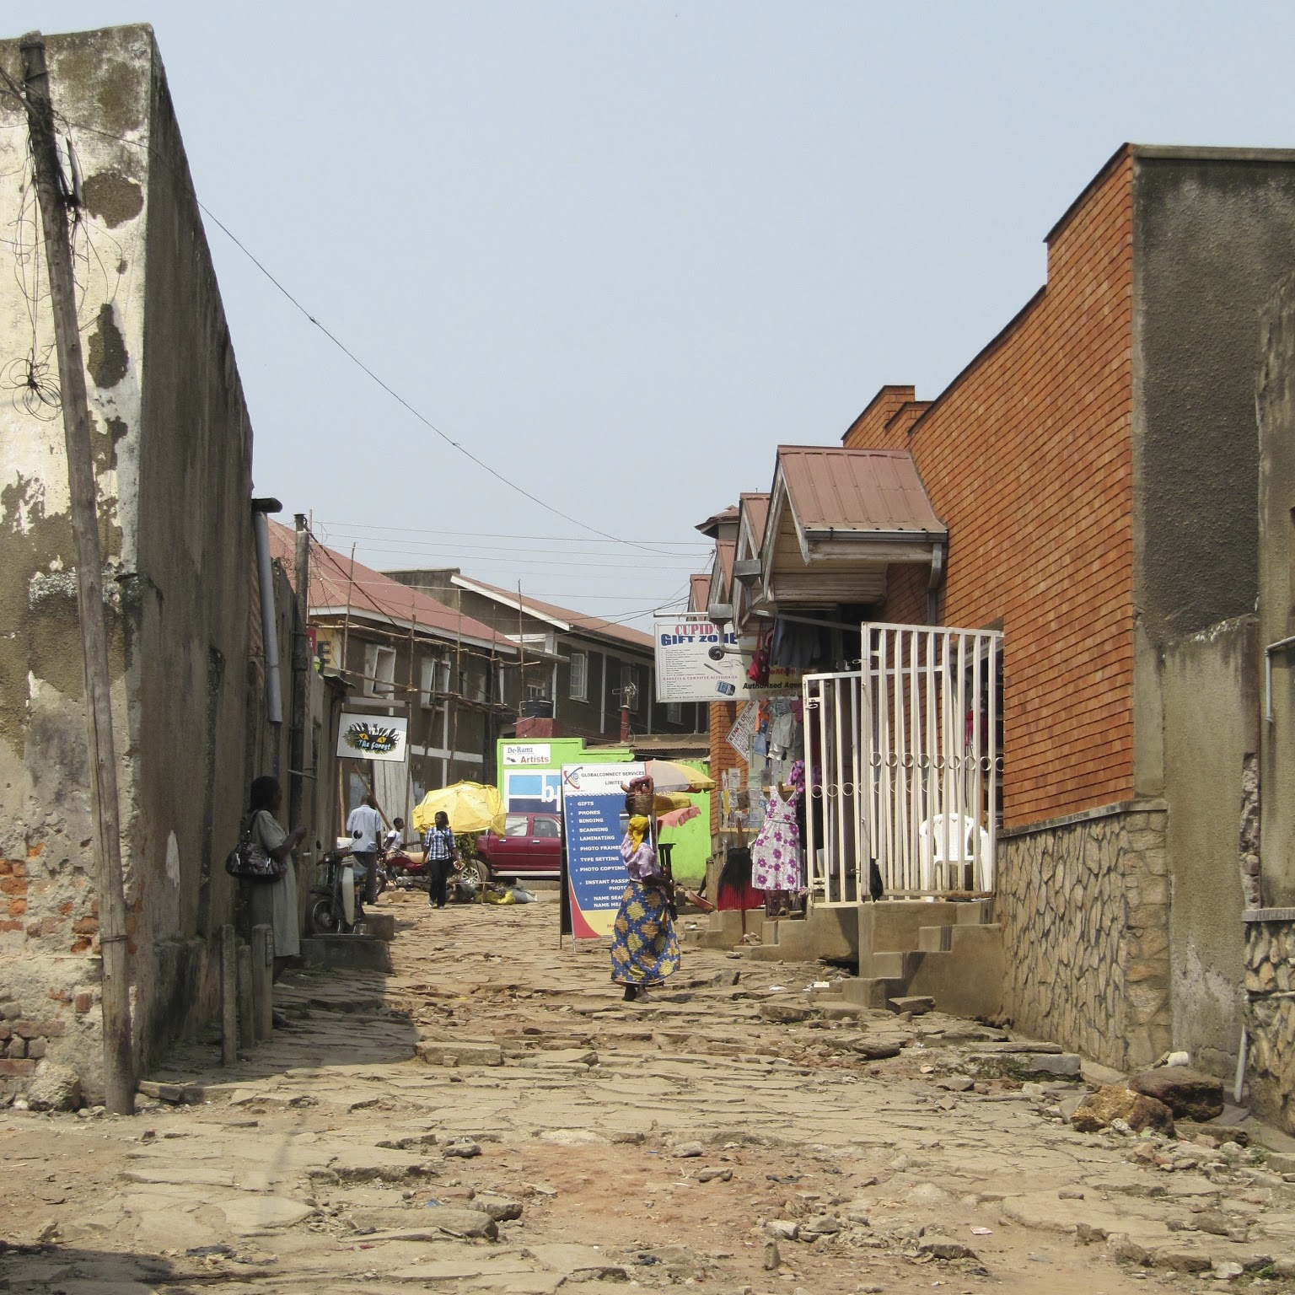
Step 3: make assumptions explicit
Identify and address any fatal assumptions
A fatal assumption is one that has a high probability of not being realized during implementation
A project containing a fatal assumption is likely to fail—hence the name
If you find a fatal assumption
If possible, redesign the project
If redesign not possible, find another early actions

Slide 26
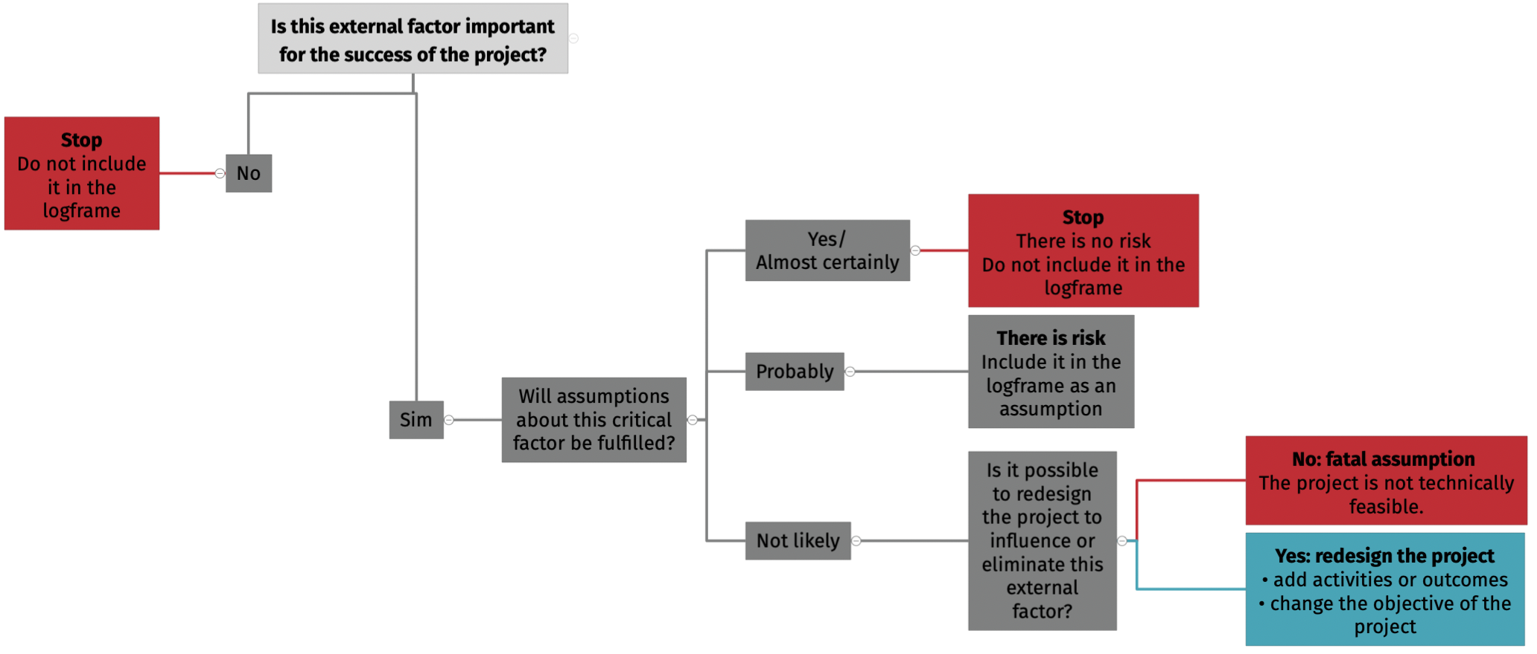
Identifying a fatal assumption
Notes:
Tiene que definir e mapear cada elemento (no necesariamente en orden)
Actividades preparativos
Preparación, pre-posicionamiento, y desarrollo de capacidades
Administrativos
Acciones previas al desencadenamiento/ preactivación (si es aplicable) (pre-trigger, early trigger)
Desencadenar
Acciones tempranas
Los resultados
Meta/objetivo final

Slide 27
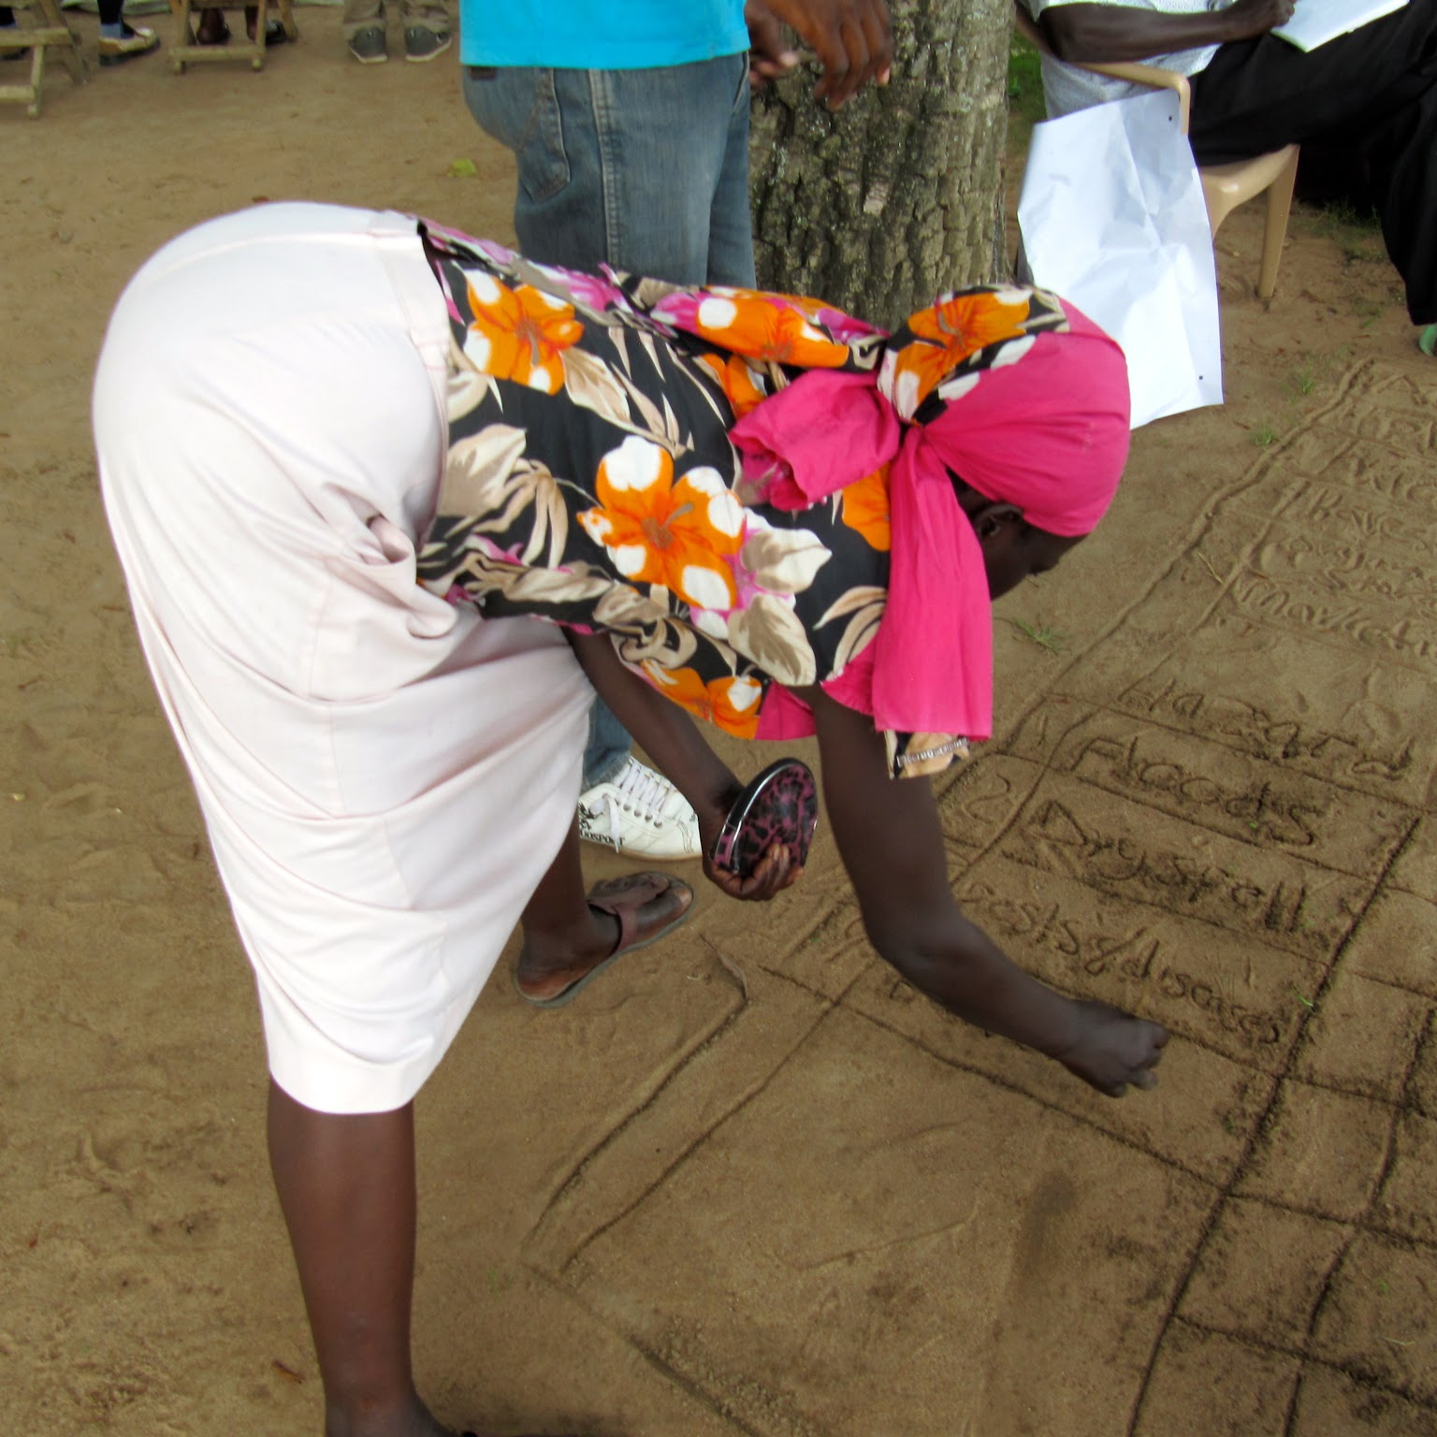
Step 4: validate your ToCs
Validate ToCs and any assumptions with key stakeholders/experts
Workshops
Interviews
Focus groups
Meetings
Simulations
Activations

Slide 28

Are we there yet?

Slide 29
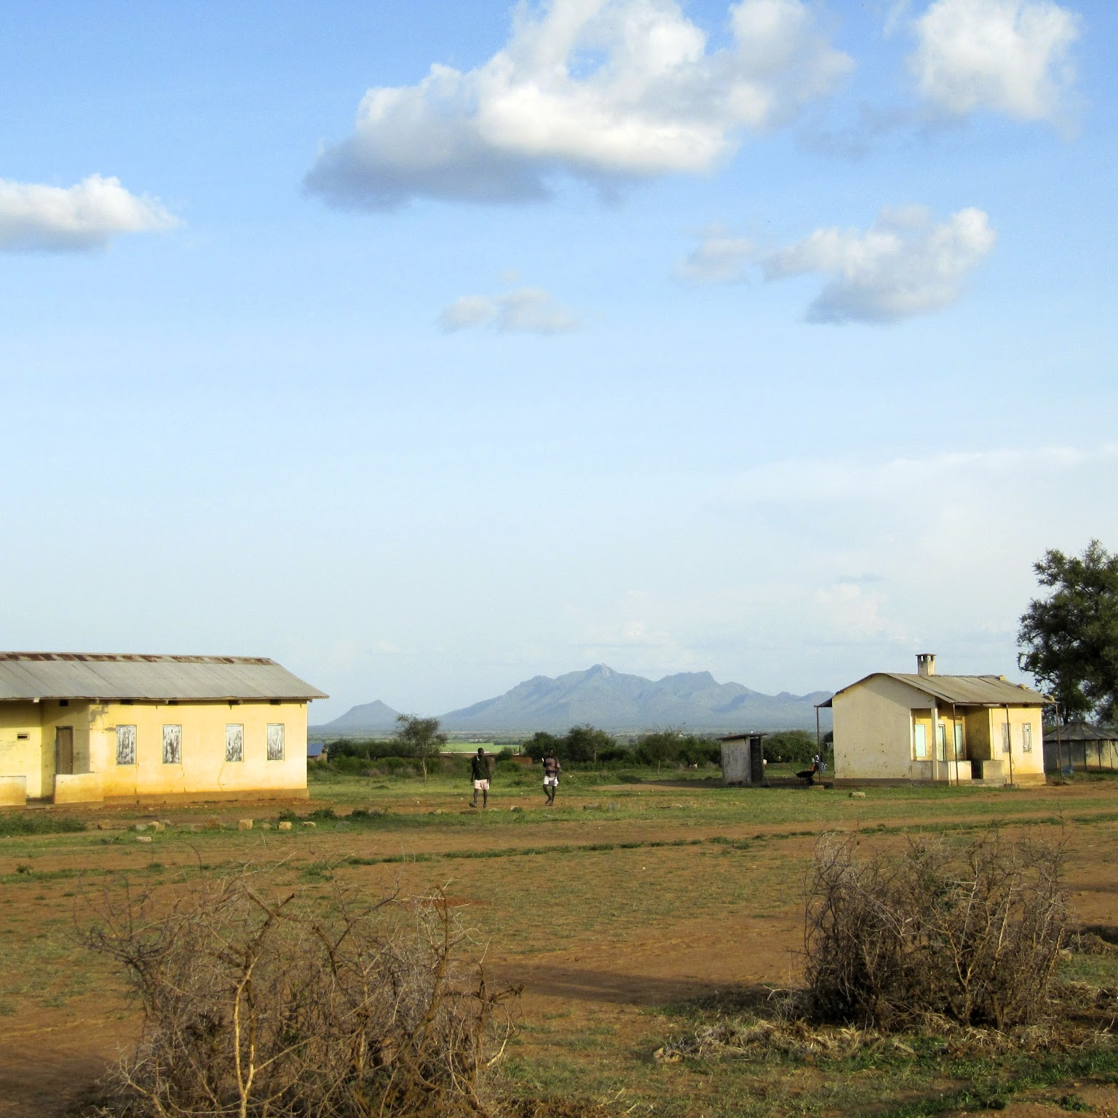
Step 5: revise as often as needed
Test/
Simulate/
Activate
Learn
Revise

Slide 30
Questions? Feedback? Discussion
Arielle Tozier de la Poterie
Arielle.tozierdelapoterie@germanredcross.de

Slide 31
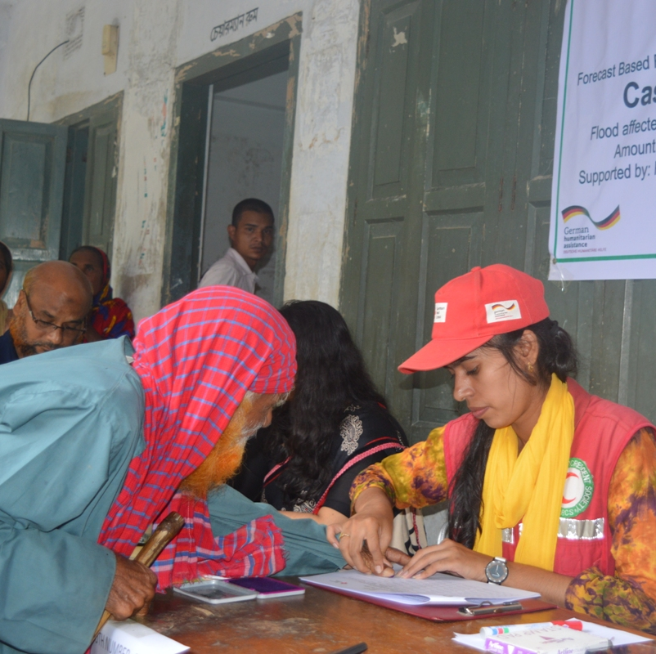
Activity: draft a ToC for one of your early actions
Choose an early action from your scenario development
Define the problem, and the objective
Map the process of change (work backward if it is useful!)
If you have time:
Make assumptions explicit
Identify any fatal flaws—can you redesign or fix them?
In the future: validate your theory and assumptions with key stakeholders & adjust as necessary

