Slide 1
Is this a “good” forecast?
Forecast skill and verification
Presentation based on Simon Mason, IRI

Slide 2
https://www.youtube.com/watch?v=r_OQ8MZcb2Q
Notes:
Discussion on: Why aren’t forecasts perfect?
Model simplifications include: resolution (averaging over a general location because we cannot model every single point with our computing limitations), parameterizations (estimations of processes that are too small for us to model - e.g. how do the molecules drag on each other and slow each other down - we just come up with an overall approximation for that); there is also uncertainty in initial conditions (exactly how did the water start out, was it already moving a little?)

Slide 3
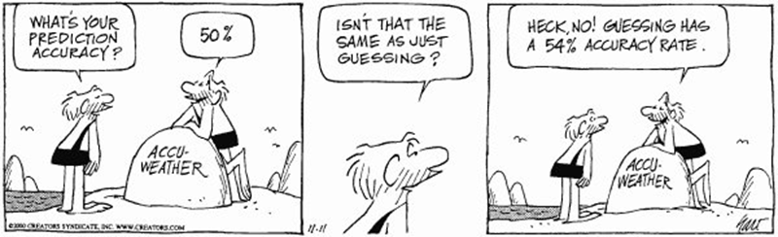
What is a “good” forecast?
Notes:
If the forecasts are correct 60% of the time, is that good?
What makes a forecast “good” (or even “correct”)?
How can we measure goodness?
Are seasonal forecasts “good”?

Slide 4
Tornado forecasts
Forecasted a tornado would happen:
Correct! Tornado did happen: 3 times
False alarm! No tornado: 7 times
Forecasted no tornado:
Miss! Tornado did happen: 2 times
Correct! No tornado: 268 times
Notes:
This is one of the most famous examples of forecasts, although I changed the numbers
Is this a good forecast?

Slide 5
Tornado forecasts
Forecasted a tornado would happen:
Correct! Tornado did happen: 3 times
False alarm! No tornado: 7 times
Forecasted no tornado:
Miss! Tornado did happen: 2 times
Correct! No tornado: 267 times
Total correct: 3 + 267 = 270

Slide 6
Is this a good forecast?

Slide 7
Comparison
Every day issue a “no tornado” forecast.
Miss! 5 tornadoes happened
Correct! 275 days without tornadoes
Total correct: 275
Notes:
If we never forecasted anything, we would have gotten “more correct”! But with the forecast we would have actually saved lives 3 times. Is “number correct” really a good way of judging forecasts? This sparked a lot of scientific thinking on how to measure the “goodness” of a forecast.

Slide 8
What makes a good forecast?
Consistency
Value
Quality
Notes:
Let’s start with consistency

Slide 9

What makes a “good” forecast?
Forecast: You will all give a 5-star evaluation of the Dialogue Platform.
Verification: I don’t actually think this, but I said it to influence you.
Forecasts are consistent when they match what the forecaster thinks.

Slide 10
When might a forecaster say something different from what he/she really thinks will happen?
Notes:
Many reasons:
To influence people (as in previous example)
Because he/she is afraid of being wrong (e.g. putting less probability on below-normal in case the drought doesn’t happen) - this is very frequent and called hedging
Because he/she wants to trigger funding/action - this could be a form of corruption with FbF if we are not careful
Others?

Slide 11
What makes a good forecast?
Consistency
Value
Quality

Slide 12
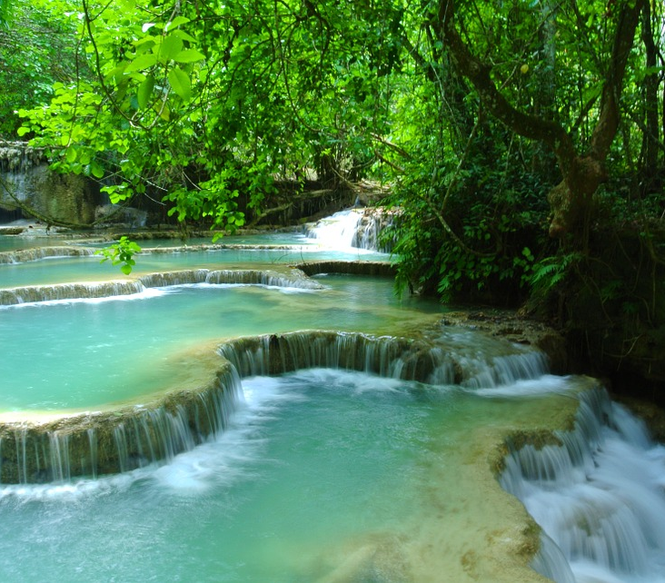
What makes a “good” forecast?
Forecast: Laos will not get the Olympic gold medal for men’s downhill skiing.
Verification: This was not news.
Forecasts are most useful when there is some uncertainty.

Slide 13

What makes a “good” forecast?
Forecast: The new Apple phone will do well when it is released.
Verification: What does “well” mean?
You can’t verify the forecast if it is ambiguous. Forecasts need to be specific.

Slide 14
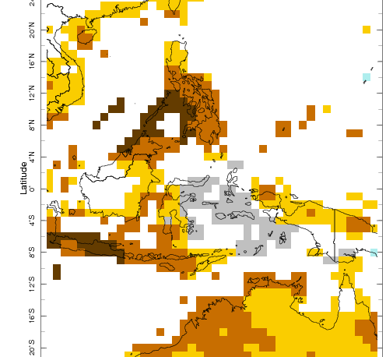
Seasonal forecasts
If rainfall is above-normal in Manila, but below-normal in the south; is the forecast “good”?
What does “normal-to-below-normal” mean?
Notes:
Is this a forecast per gridbox? For the average conditions across the gridbox? Does it apply to specific cities?

Slide 15
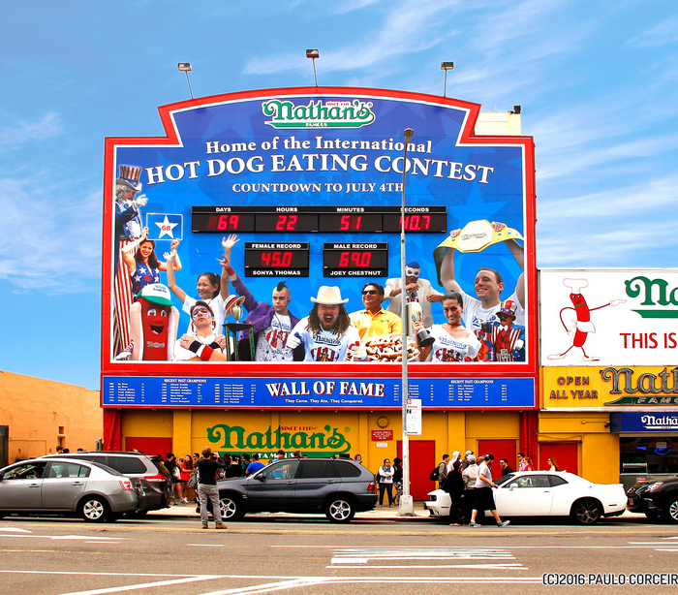
What makes a “good” forecast?
Forecast: Joey Chestnut will win the hot dog eating contest in the US in 2019.
Verification: Who cares?
Forecasts are only useful when they have value (when they are salient).

Slide 16
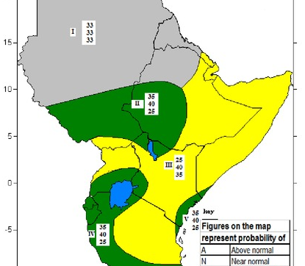
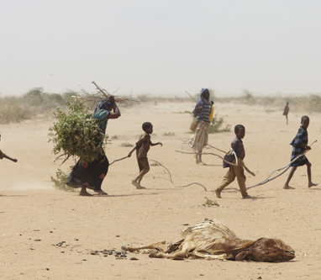
Salience (value)

Slide 17
What makes a good forecast?
Consistency
Value
Quality

Slide 18

What makes a “good” forecast?
Forecast: Chelsea will beat Manchester United 2-1.
Verification: Chelsea won 1-0.
Correctness is only one aspect of forecast quality.

Slide 19
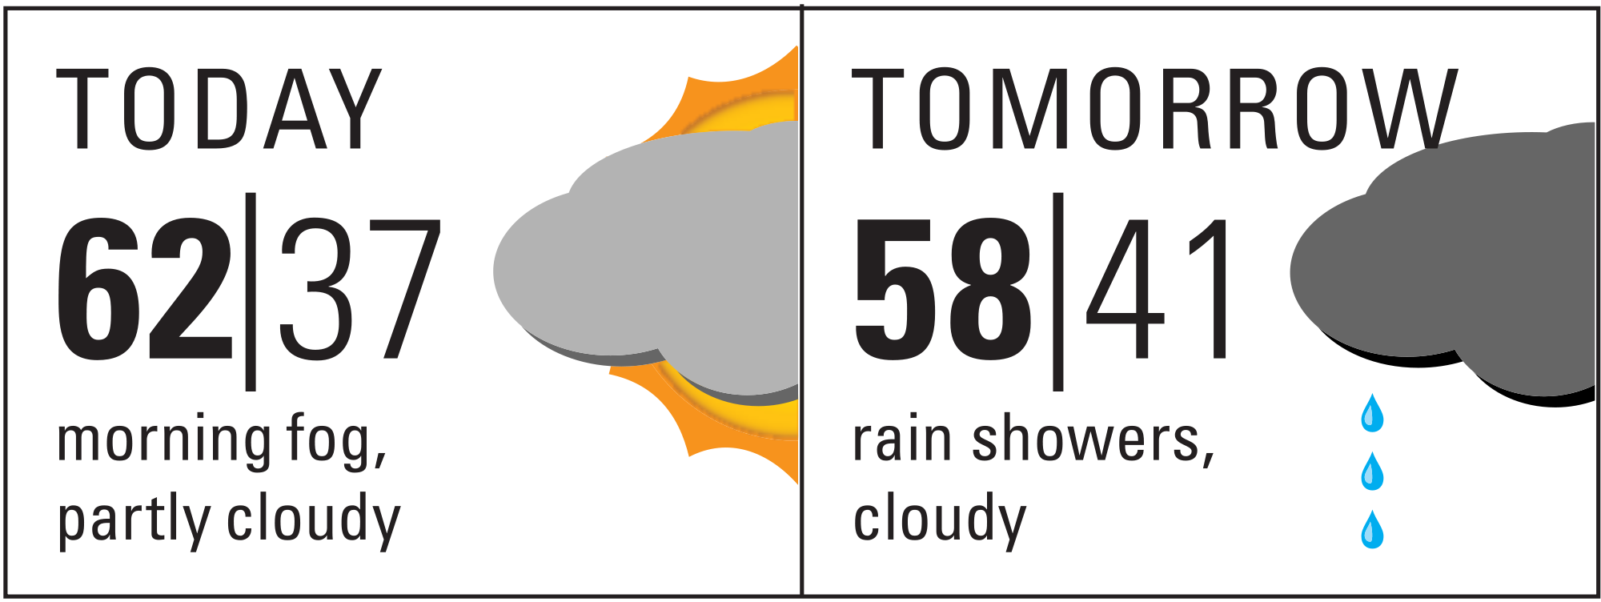
Some forecasts are deterministic

Slide 20
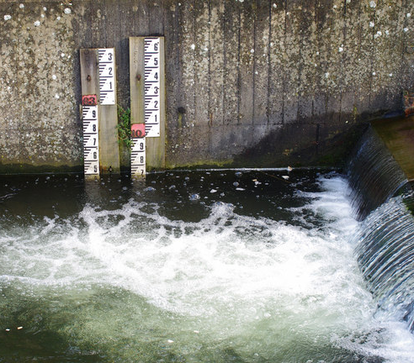
What makes a “good” forecast?
Forecast:Tomorrow the water level will be 2.3 meters.
Verification: It was 2.5 meters, but still above our danger level..
Deterministic forecasts need to be evaluated regarding false alarms and missed events..

Slide 21
Evaluating historical success
Yes forecast >= p

Slide 22
Evaluating historical success
 | Yes disaster | No disaster
Yes forecast >= p | Hits a(p) | False Alarm b(p)

Slide 23
Evaluating historical success
 | Yes disaster | No disaster
Yes forecast >= p | Hits a(p) | False Alarm b(p)
No forecast >= p | Miss c(p) | Correct Rejection d(p)

Slide 24
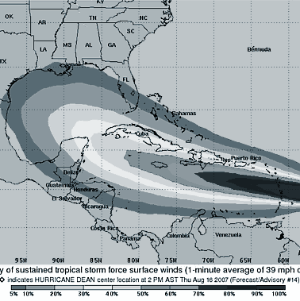
Some forecasts are probabilistic

Slide 25
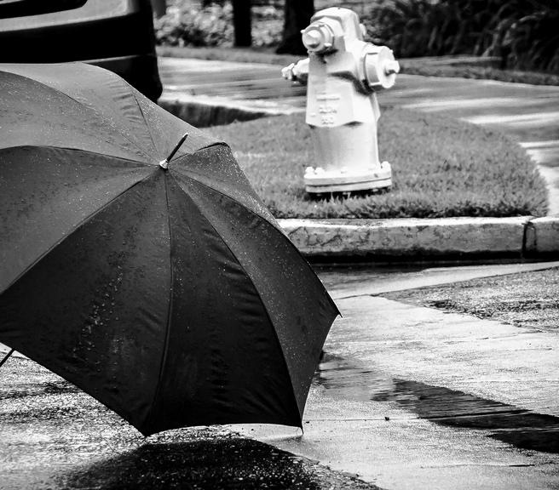
What makes a “good” forecast?
Forecast: 20% chance of rain tomorrow.
Verification: It rained every time I issued a 20% forecast.
I should have issued a 100% forecast. My probabilities were not reliable.
.

Slide 26
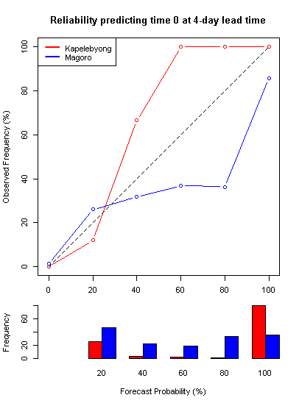

Slide 27

What makes a “good” forecast?
Forecast: There is a 51% chance of this coin landing on “heads”.
Verification: Yes, but that is not giving us much difference from “climatology”.
Forecasts are most useful when the probabilities are sharp.

Slide 28
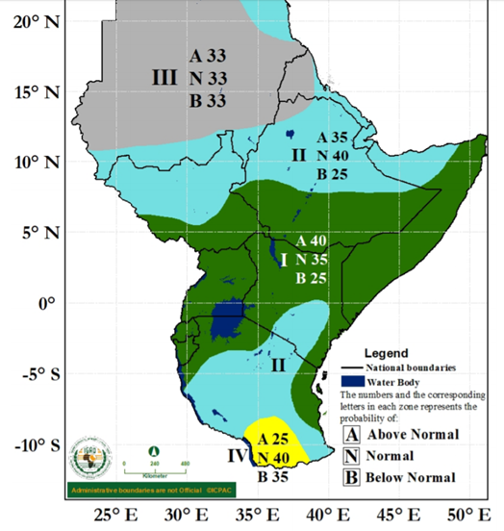
Sharpness

Slide 29
How well can we predict extreme events?
Forecast skill around the world

Slide 30
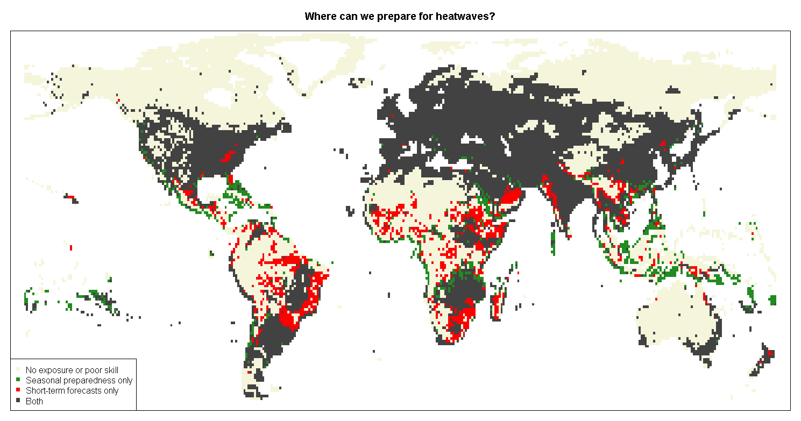
Heatwaves
Notes:
See: http://iopscience.iop.org/article/10.1088/1748-9326/aab94a/meta

Slide 31
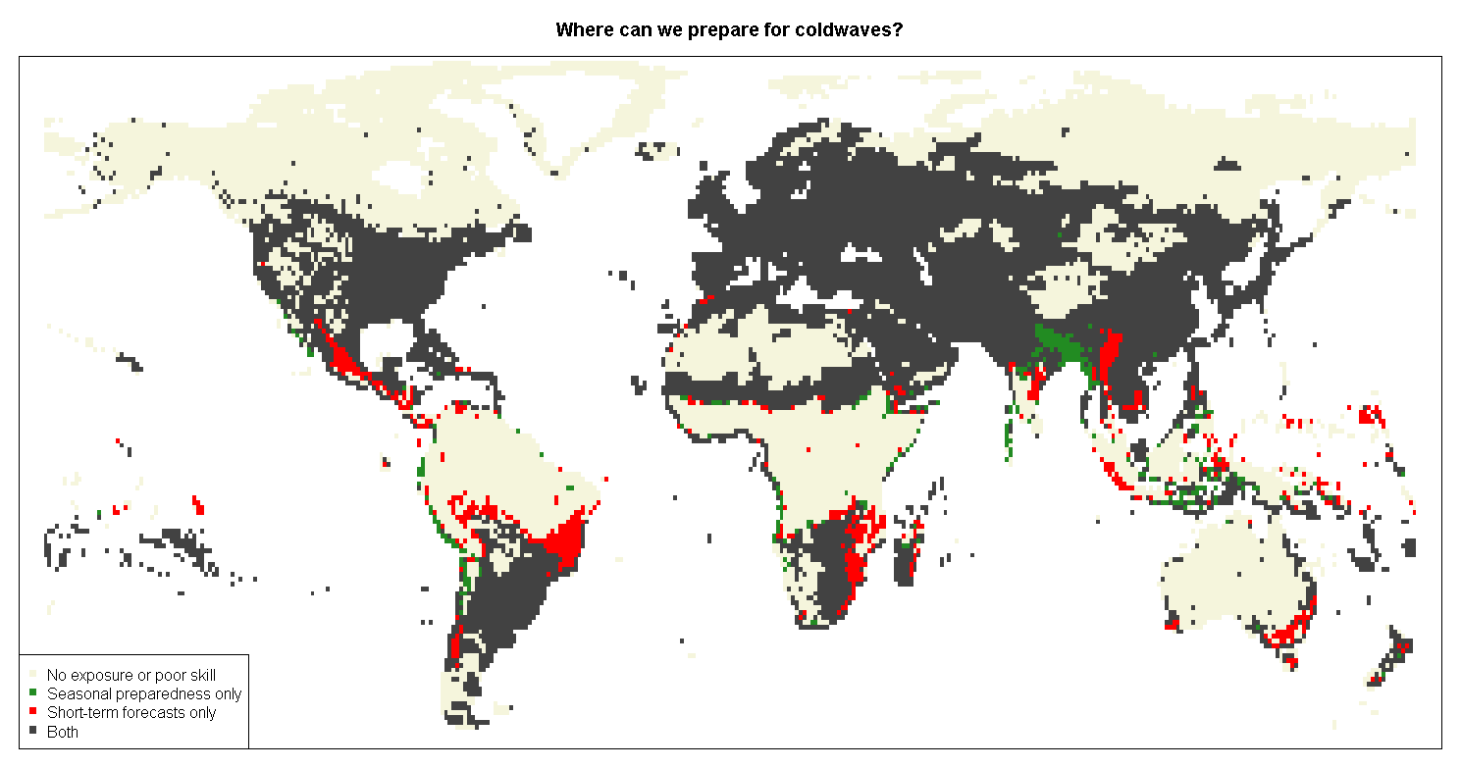
Notes:
See: http://iopscience.iop.org/article/10.1088/1748-9326/aab94a/meta

Slide 32
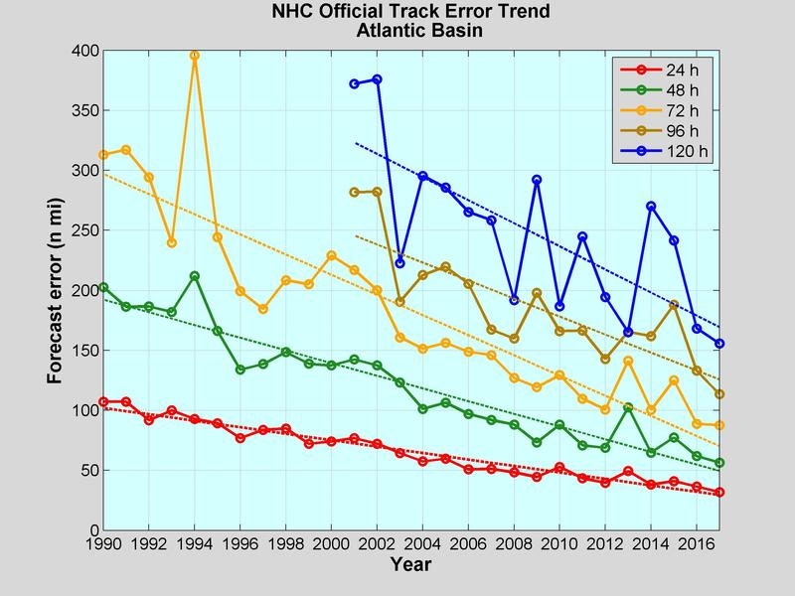
Notes:
From NOAA - improvement in forecast skill for tropical cycloens in the Atlantic

Slide 33
Droughts and Floods?

Slide 34
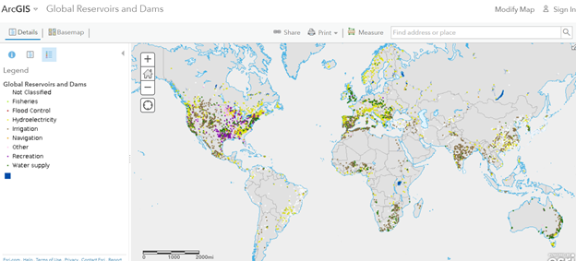
Notes:
This is a map of many of the dams in the world - note that anywhere downstream of a dam should be able to forecast flooding because it is caused by humans releasing water - humans can pass the early warning before they release the water

